Slide 1
Outcome Oriented Teaching Learning Methodology
Dr. Sunil Kumar Sharma

Slide 2
Contents:
Objective
Pedagogic technique
Template Session Plan
Session Sample
Teaching Learning Strategies
Conclusion

Slide 3
Objective:
Different existing teaching learning methodologies
  Traditional classroom teaching
  Chalk and desk Methodology
  E-Learning
  Social Network in teaching learning
The objective of the current topic is to focus on new teaching learning methodologies
  Student centered teaching
  Interactive teaching learning sessions
  Problem solving pedagogy
  Analogy with specific outcomes

Slide 4
Teaching Learning Strategy
It is scientifically proven that Human brain can not focus on one topic not more than 15 minutes
The session must include internal shift of teaching strategies to break monotonous session.
Involvement of the learner in teaching learning.

Slide 5
Pedagogic Techniques
Various methods, like Brainstorming and Puzzles, can be used in order to impart effective teaching and ensure active participation of learners in the classroom.
Each method, in turn, has numerous techniques and variations which will enable learners achieve different knowledge levels of Blooms Taxonomy and Gardener‘s Multiple Intelligence.
The following table can be used as a quick reference to select appropriate pedagogic techniques.

Slide 6
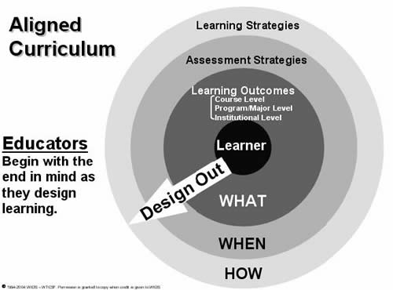

Slide 7
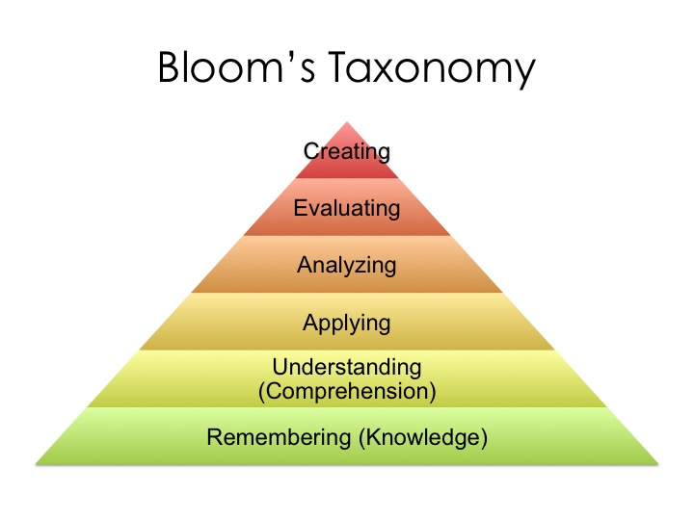

Slide 8
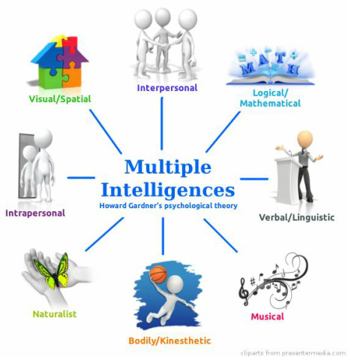

Slide 9
Pedagogic Methods
Brainstorming
Innovative Introduction
Mnemonic Instruction
Puzzles
Questioning Skills
Quiz
Role Play
Seminar
Case Study
Demonstration
Games
Group Discussion
Impersonation
Innovation conclusion
e-Learning

Slide 10
Brainstorming
Overall Objectives of Brainstorming
To generate large number of creative ideas.
To introduce innovation in application.
To encourage self learning.
Types of brainstorming
1. Individual Brainstorming: This involves allotting a task/theme and asking people to work on it individually. The individual ideas are then consolidated.
2. Group Brainstorming: In this method, group/s consisting of at least eight participants is formed for a said task/theme (this is a more prevalent form of brainstorming).

Slide 11
Method | Techniques | Blooms Level | Intelligence Level
Brainstorming | Problem Solving | Remembering/ Knowledge Analysis Application | Mathematical -Logical Interpersonal Intrapersonal
 | Model Making | Understanding/ Comprehension Application | Mathematical -Logical Interpersonal Linguistic
 | Simplification | Understanding/ Comprehension | Mathematical -Logical Interpersonal

Slide 12
Brainstorming Techniques
Problem Solving | Procedure Form 4 to 5 groups of learners Present the problem to the groups with a brief explanation of the problem. Ask Groups to come up with different ways of resolving the given problem within the stipulated time, and present their solutions. Begin the process of brainstorming for generating ideas Encourage/create space to generate wild ideas Avoid criticism of ideas put forth by participants during brainstorming session. Focus on quantity. Primary function of brainstorming is to generate large number of ideas. Select ideas that are relevant, appropriate, applicable and creative. Integrate the ideas, improvise and reach a conclusion regarding what could be the most appropriate solution.

Slide 13
Specific Objectives | To understand fundamental concepts/theories in unconventional/novel ways To assess the level of learning of the learners in the classroom
Application Areas | As a closure activity towards the end of the lesson
Facilitator’s role | Designs a Problem (mathematical/mechanical etc) Facilitates the brainstorming session Helps learners arrive at a solution or solutions Ensures the involvement of the entire class
Learner’s role | Forms groups to find out different ways of solving the problem within the theoretical framework Actively participates in the brainstorming session One learner records all the ideas generated.
Blooms Taxonomy Learning levels Achieved | Understanding Analysis Application
Multiple Intelligence Levels Developed | Mathematical-Logical Interpersonal Intrapersonal

Slide 14
E –Learning:
The use of technology provides a range of possible learning experience which is difficult to achieve in the face-to-face classroom. There is a wide range of activities of different levels of sophistication, ranging from as simple as email question and answers, or online forums to highly sophisticated simulations.

Slide 15
Session Plan for teaching-learning methodology of Dijkstra Algorithm
Session Name: | Dijkstra Algorithm
Author Name: | SUNIL SHARMA
Department: | MATHEMATICS
Number of students in the class: | 60
Subject/Course: | Graph Theory
Phone number: | 016405388
E-mail address: | s.sharma@mu.edu.sa

Slide 16
Session Objectives
At THE END OF THIS SESSION, THE LEARNER WILL BE ABLE TO:
Define Minimum Spanning Tree (MST) & Shortest Path Problem (SPP).
Differentiate between MST and SPP
Explain the Steps of Dijkstra Algorithm
Calculate the shortest path from the source vertex.
Apply the concept of single source shortest path algorithm in real life problems e.g. Airline flight times, Computer networks response times etc.

Slide 17
Session Plan
Time (in min) | Content | Learning Aid and Methodology | Faculty Approach | Typical Student Activity | Learning Outcomes (Blooms + Gardeners)
10 | MST & SPP | Analogy, PPT | Explain | Listens | Understanding linguistic Intrapersonal
15 | Dijkstra Algorithm | Chalk and Talk, Chart Presentation | Explain | Listens & Analyse | Understanding Intrapersonal Logical
15 | Demonstration of Dijkstra Algorithm | Role play | Facilitates | Participates, Observes | Understanding, Applying Linguistic Intrapersonal, interpersonal
10 | Application of Dijkstra Algorithm | Prototype Model, Chart | Demonstrates | Listens, Calculates Interprets | Understanding, Applying Analyzing Intrapersonal, Spatial Logical
5 | Conclusion | Rapid Fire | Facilitates Questions | Answers | Remembering, Understanding Interpersonal, Mathematical & Logical Linguistic

Slide 18
SESSION SUMMARY:
AT THE END OF this session THE LEARNER WILL BE ABLE to:
Explain MST & SPP
Concept of Dijkstra algorithm
Identify and illustrate the conditions of Dijkstra algorithm
Analyse the cost of various paths from the source vertex
Application of Dijkstra algorithm

Slide 19
Background
Learners found difficulty to understand the Dijkstra algorithm as in the selection of the node and the conversion of temporary node to permanent node by connecting with right edge. Which is difficult to understand through traditional chalk and Board approach of learning? To understand this concept I have given a task to learners to make a role play to define the Dijkstra algorithm involving the maximum students of class. The role of the other group of participant was to give the values to the nodes and uses ropes in place of edges with assigning direction and nonnegative weights to decrease the complexity for better understanding apart from this the prototype model is used to give students better vision and clarity.
CHALLENGES IN IMPLEMENTATION
Session plan took more time and effort for preparation. The development of new and innovative approach for this topic. Session plan should build such that the students get the practical approach over it. Time Management was a challenge as the activity was dynamic in nature. Active participation from the learners as they are not habitual of doing such activity and role play was a new activity for them.

Slide 20
LEARNING OUTCOMES ACHIEVED BY LEARNERS
Found Dijkstra algorithm learning very interesting and easy. Participated actively. Improvement in analytical skills. Interpersonal, Intrapersonal, visual and linguistic skills improved. Teaching paradigm shifted from faculty to learners. The learners themselves formed the group and conducted the activity and hence paradigm shift was there.
LEARNERS FEEDBACK
Understanding the algorithm very interestingly. Found learning in the class very interesting. Found digital and circuit representation effective. Happy to have a lively classroom environment as they had fun with study. Found the role play very effective.
ANY EXTRA INPUTS (Please fill in the Box below)
Board and Chalk Analogy Role Play Prototype Model

Slide 21
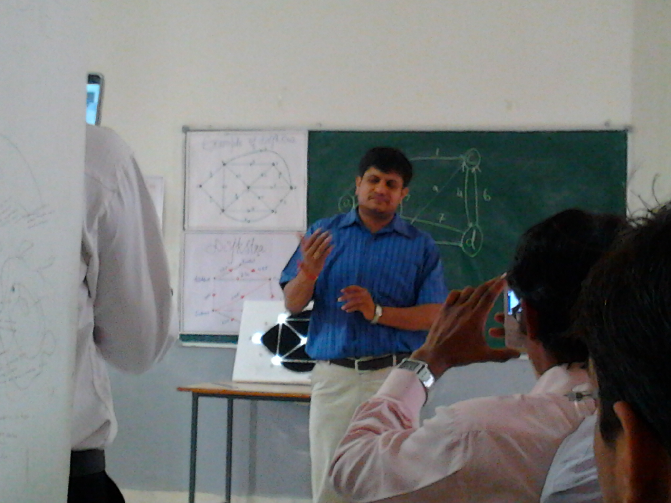
Analogy Discussion

Slide 22
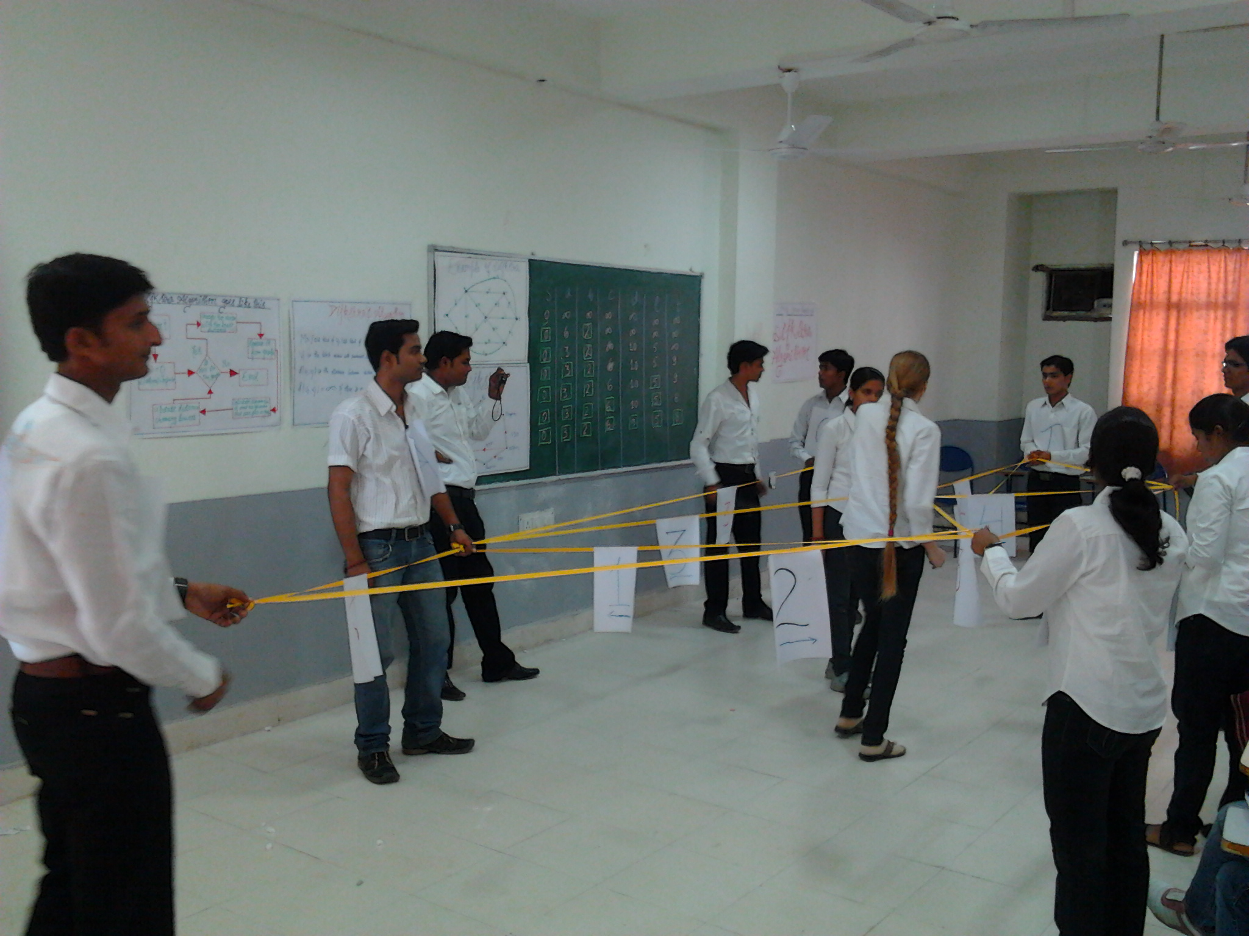
Role Play

Slide 23
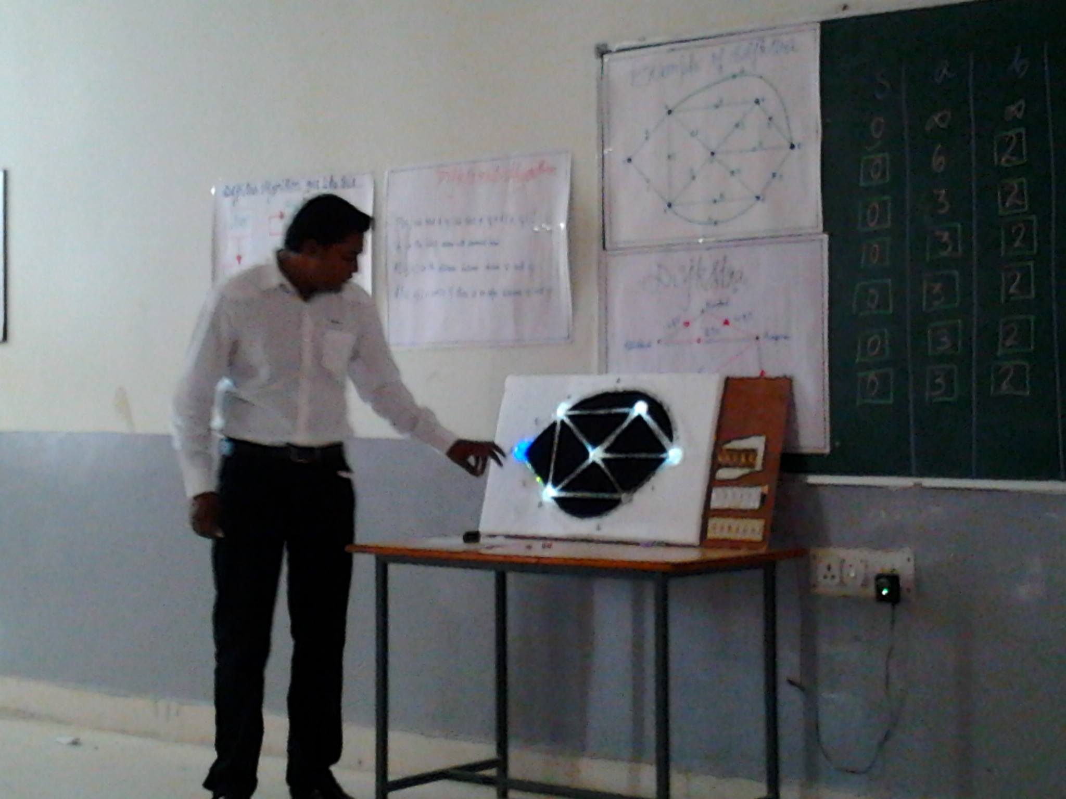
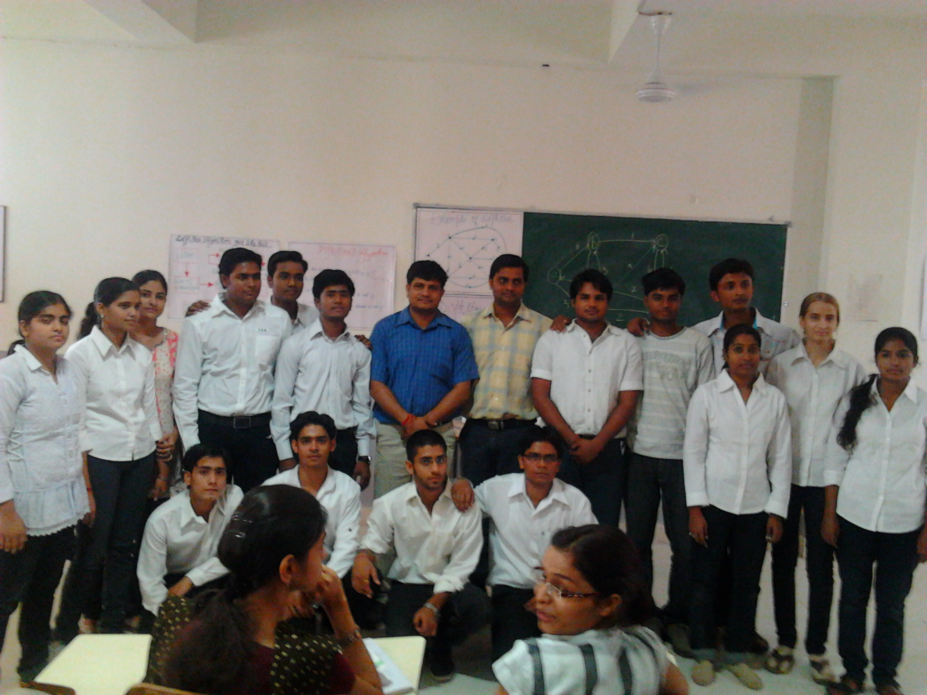
Prototype Model:

Slide 24
Thanks

